Slide 1

Music store Report
Presented by : Sachin Pal

Slide 2
Content
1. Overview 2. Problem statement 3. Dataset and model diagram 4. Report 5. Recommendations

Slide 3
Company Overview
Sangeet , a digital music store which takes care the demand of all music fans and provides their services all over world

Slide 4
Problem statement
A new team has been formed to analyze the company's current state with the objective of driving strategic business growth and improving user experience. As a junior data analyst, I have been assigned the task of creating a report that addresses all questions, which will help the team to understand the data and make informed decisions.

Slide 5
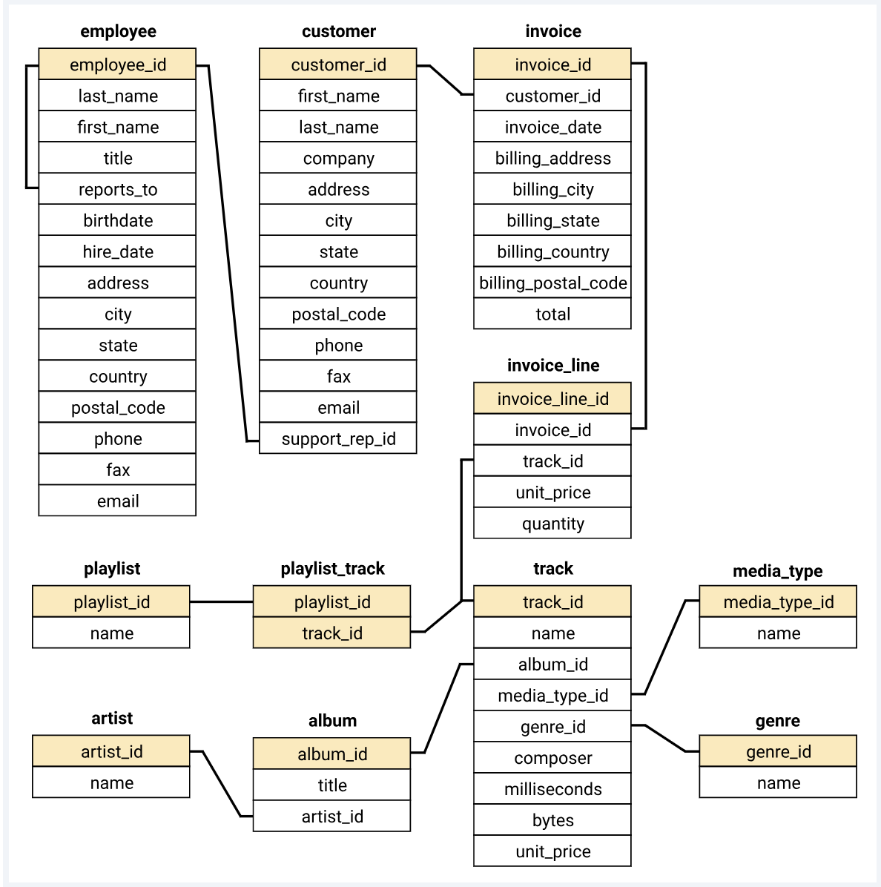
Dataset
[Music_Store_database]– SQL file to analyse the data
And csv file for each table

Slide 6

Requests , output and insights
Request 1 :
Who is the senior most employee based on job title ?
input
select * from employee
order by levels desc limit 1 ;
output

Slide 7
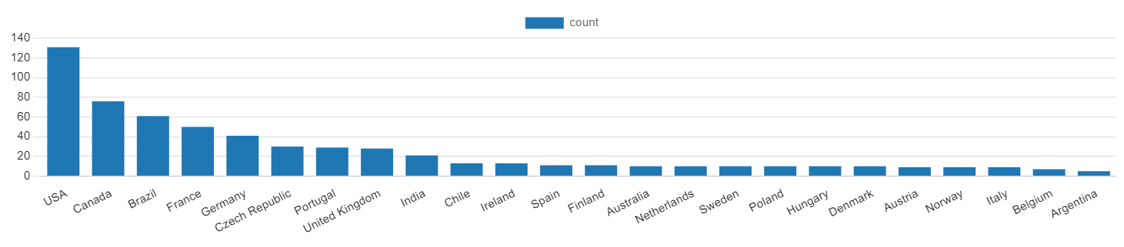
Request 2 :
Which country have the most invoices ?
input
select billing_country , count ( billing_country ) from invoice
group by billing_country
order by 2 desc;
output
insights
Country with most no. of invoices is USA followed by Canada & brazil .

Slide 8
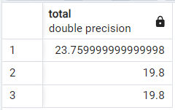
Request 3 :
What are top 3 values of total invoice ?
input
select total from invoice
order by 1 desc limit 3;
output

Slide 9

Request 4 :
Which city has the best customers? We would like to through a promotional music festival in the city we made the most money. Write a query that returns one city that has the highest sum of invoice total. Return both city name & sum of all invoice totals
input
select billing_city, sum(total) as grand_total from invoice
group by billing_city
order by 2 desc limit 1;
output
insights
Prague is the city with highest sum of invoice total of $273 we can host the promotional music festival their.

Slide 10

Request 5 :
Who is the best customer? The customer who has spent the most money will be declared the best customer. Write a query that returns the person who has spent the most money
input
select c.customer_id, c.first_name, c.last_name, sum(i.total) as grand_total from customer c join invoice i on c.customer_id = i.customer_id
group by 1
order by 4 desc limit 1;
output

Slide 11
Request 6 :
Write query to return the email, first name, last name & genre of all rock music listeners. Return your list ordered alphabetically by email starting with A
input
select email, first_name, last_name from customer c
join invoice i on c.customer_id = i.customer_id
join invoice_line il on i.invoice_id = il.invoice_id
where track_id in
(
select track_id from track t
join genre g on t.genre_id = g.genre_id
where g.name like 'Rock’
)
group by 1,2,3 order by 1;

Slide 12
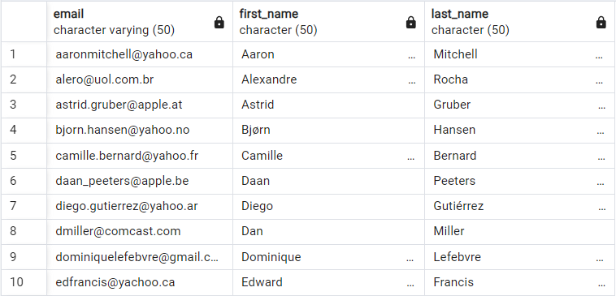
output
* Full output in file : Q6.email_name

Slide 13
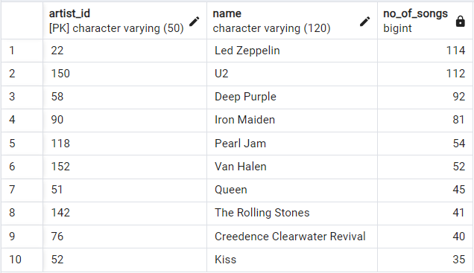
Request 7 :
Lets invite the artists who have written the most rock music in our dataset. Write a query that returns the artist name and total track count of the top 10 rock bands
input
select a.artist_id, a.name, count(a.artist_id) as no_of_songs from track t
join album al on t.album_id = al.album_id
join artist a on al.artist_id = a.artist_id
join genre g on t.genre_id = g.genre_id
where g.name like 'Rock'
group by 1
order by 3 desc limit 10;
output

Slide 14
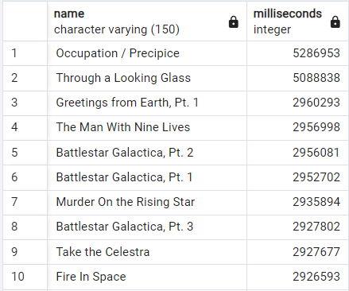
Request 8 :
Return all the track names that have a song length longer than the average song length. Return the name and milliseconds for each track. Order by the song length in descending ?
input
select name , milliseconds from track
where milliseconds >
(
select avg(milliseconds) from track
)
order by 2 desc;
output

Slide 15
Request 9 :
Find how much amount spent by each customer on artists? Write a query to return customer name , artist name & total spent?
input
with best_selling_artist as
(
select a.artist_id, a.name, sum(il.unit_price*quantity) as total_spend from invoice_line il
join track t on il.track_id = t.track_id
join album al on t.album_id = al.album_id
join artist a on al.artist_id = a.artist_id
group by 1
order by 3 desc limit 1
)
select c.customer_id, c.first_name, c.last_name, bsa.name, sum(il.unit_price*quantity) as spend
from invoice i
join customer c on c.customer_id = i.customer_id
join invoice_line il on i.invoice_id = il.invoice_id
join track t on il.track_id = t.track_id
join album al on t.album_id = al.album_id
join best_selling_artist bsa on al.artist_id = bsa.artist_id
group by 1,2,3,4
order by 5 desc;

Slide 16
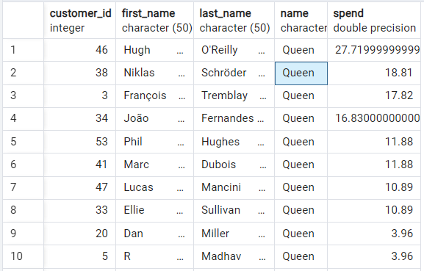
output
* Full output in file : Q.9(spend by customer )

Slide 17
We want to find out the most popular music genre for each country. We determine the most popular genre as the genre with the highest amount of purchase. Write a query that returns each country along with the top genre. For countries where the maximum no of purchases is shared return all genres
Request 10 :
input
with popular_genre as
(
select c.country , sum(quantity) , g.name , g.genre_id ,
row_number() over(partition by c.country order by sum(il.quantity) desc) as rowno from customer c
join invoice i on c.customer_id = i.customer_id
join invoice_line il on il.invoice_id = i.invoice_id
join track t on t.track_id = il.track_id
join genre g on g.genre_id = t.genre_id
group by 1 ,3 , 4
order by 1 asc , 2 desc
)
select * from popular_genre where rowno = 1 ;

Slide 18
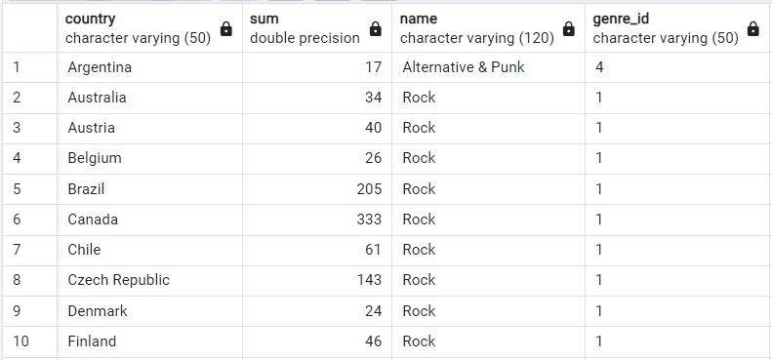
output
* Full output in file : Q.10(most popular genre)

Slide 19
Recommendations
Partner with rock artists because it is the most sold genre with the top in 23 out of 24 countries.
Personalization of new released to potential customers
Prague is the city with highest sum of invoice total of 273 .we can host the promotional music festival here
Optimize Pricing Models for each country can help us to grow

Slide 20
Thank you !

